Slide 1



Slide 2
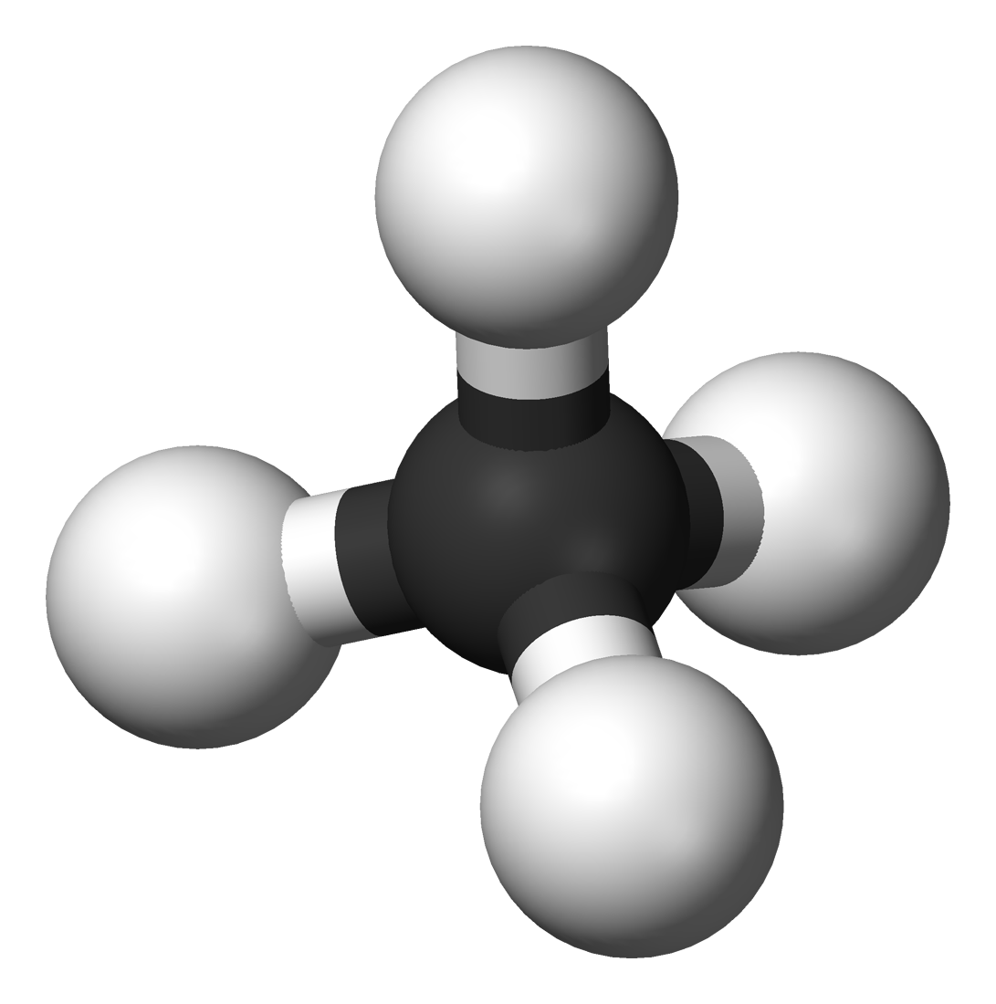
HYDROCARBON
Presented BY:
C.VISHAAL(15BCS2113)
SHEikh abutahir(15BCS2305)
GUIDED BY :
MISS S.GOWRI(AP/S&H)

Slide 3

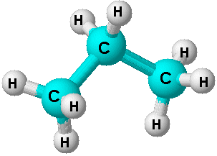
HYDROCARBON MEANS?
HYDROCARBON:
hydrocarbon is defined as the mixture of an hydrogen and carbon in different in the count of hydrogen and carbon molecules.

Slide 4
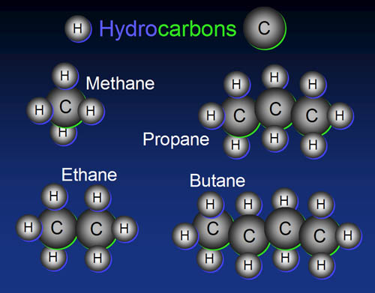
Types of hydrocarbon
Methane
Ethane
Propane
Butane . etc

Slide 5
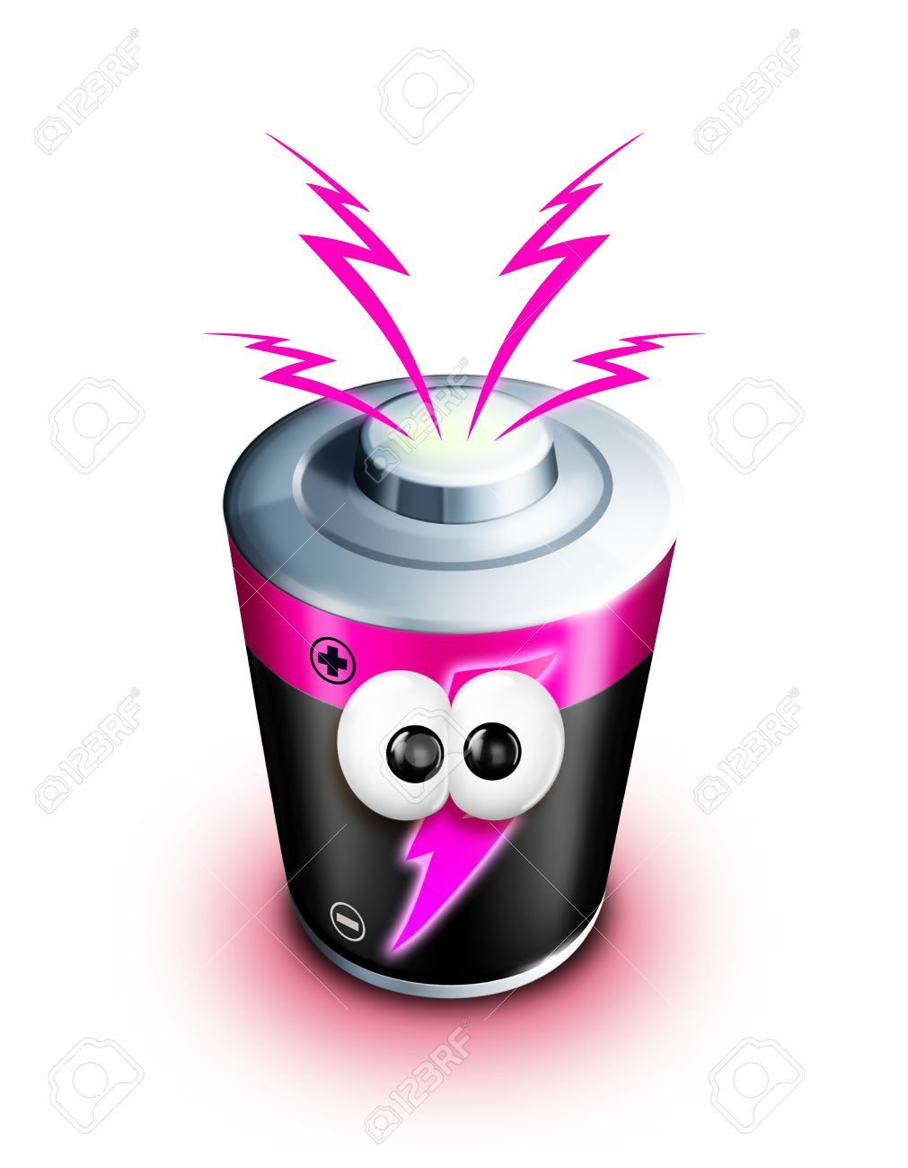
what can we do with hydrocarbon
The hydrocarbon are found in the core of earth .
They are used to create electricity .
The reduces the money used in extraction of other fuels.
Small amount of hydrocarbon gives more energy

Slide 6
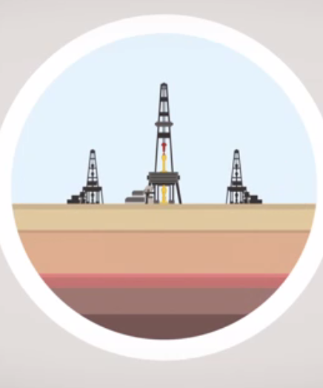
How it is extracted
The hydrocarbon is extracted from the earth surface .
The process of removing the hydrocarbon required water sand and chemicals and the technique is called fracking.
For fracking the earth is drilled for several kilometer under the earth and the shaft is moved to the materials that has hydrocarbon.
Then the fracking fluid is passed and the sand is used to keep the cracks from closing again the chemicals are used to bring the hydrocarbon out .

Slide 7
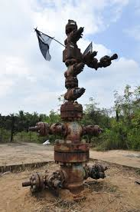
neduvasal
The neduvasal plays the major role in exposing the problem of the hydrocarbon .
Why they oppose it .
The place located in tanjore district.

Slide 8
Why they oppose it ?
The hydrocarbon plays the major role in the power source .
The major problem is the source is near the living area .
The toxic gas is exposed in tamil nadu we already suffering from water scarcity so if they take hydrocarbon they need lot of water and they have to add chemicals creates the major impact of our farming lands

Slide 9
Effects of hydrocarbon
Ground water gets polluted .
Earthquake is formed due to the deep penetration .
Humans and animals get affected.
Air gets mixed with hydrocarbon gases .
Forms greenhouse effect.
Global warming.
Reduce of ground water level.

Slide 10
Dangerous effects of fracking
It required 8 million liters of water that enough to fill the daily usage of 6500 family for their daily consumption.
And several liters of chemicals of poured into the earth surface.
After some reaction the fracking fluid is removed out.

Slide 11
Which country uses hydrocarbon
United states
Japan
China
South Korea
Russia
Saudi Arabia
Brazil
Germany

Slide 12
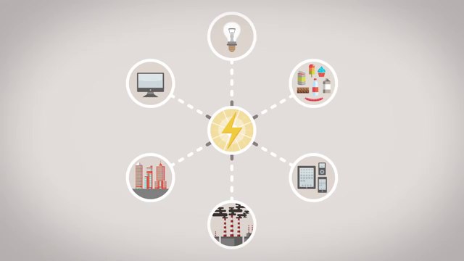

Slide 13
Other ways to take hydrocarbons
The hydrocarbon can be extracted from waste which we throw day by day.
Coal and petroleum .

Slide 14
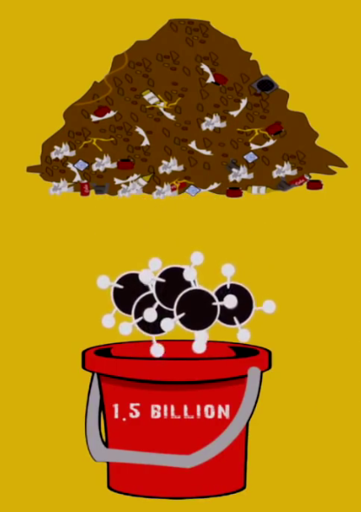
How much we get from waste

Slide 15


Slide 16

ANY QUERIES

